Slide 1
Interpolation: Diagonal and horizontal differences

Slide 2
In interpolation, particularly in finite differences or difference tables, we often compute diagonal and horizontal differences to estimate the value of a function between known data points.

Slide 3
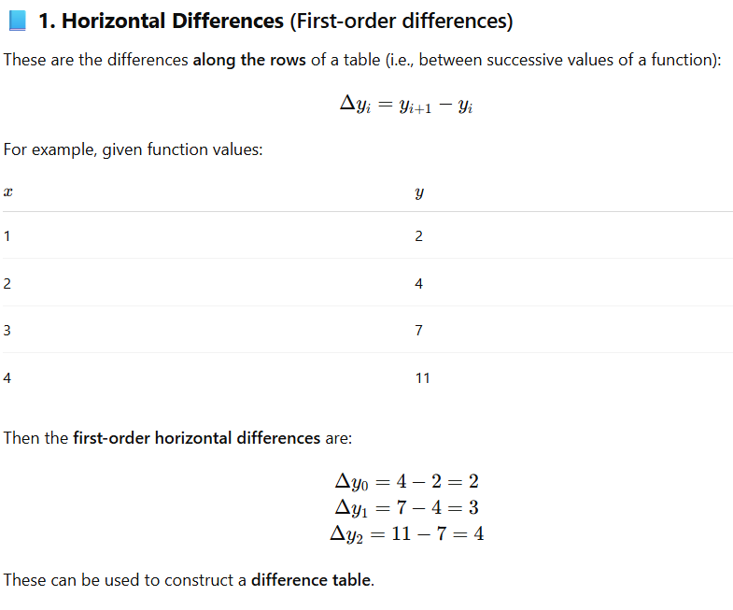
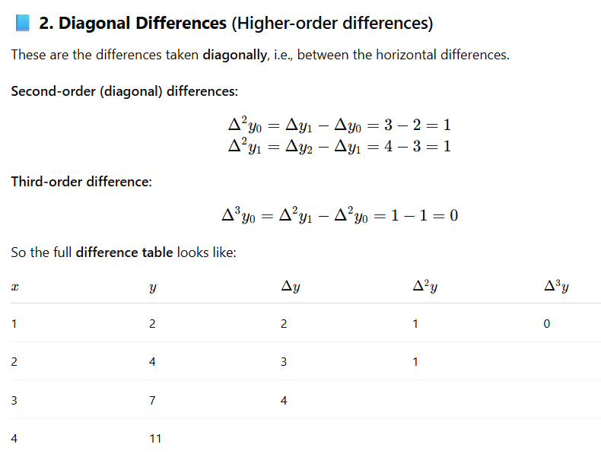

Slide 4
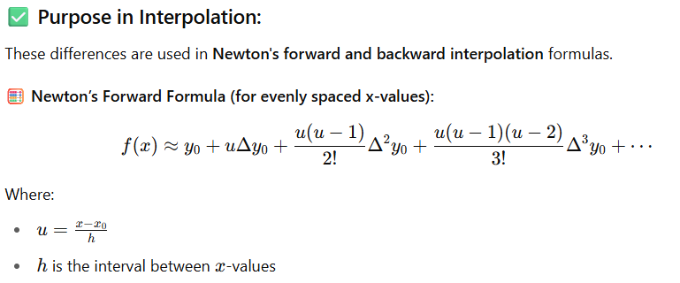
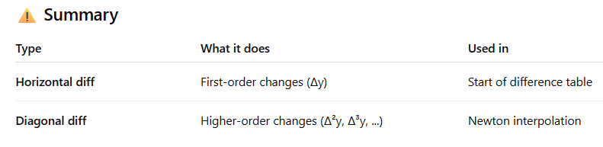

Slide 5
Differences of a polynomial
For a polynomial of degree n, the n^{-th} order finite difference is constant, and all higher-order differences are zero.
Finite differences (forward, backward, etc.) computed from the function values of the polynomial at evenly spaced points.

Slide 6
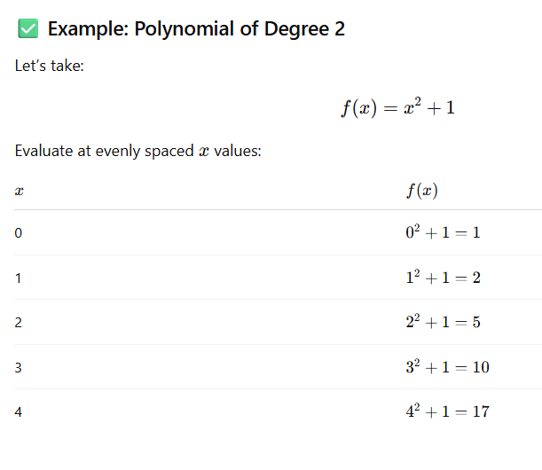

Slide 7
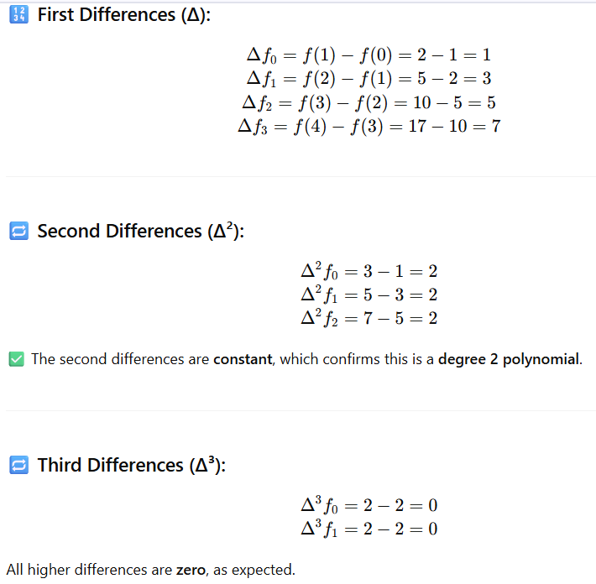
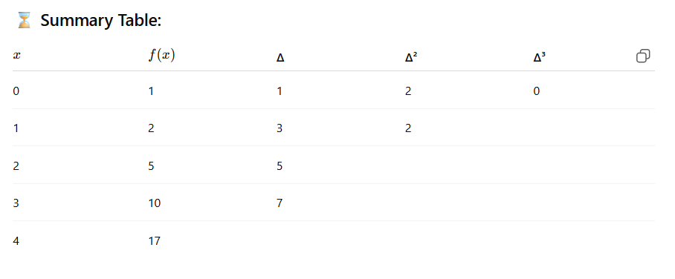
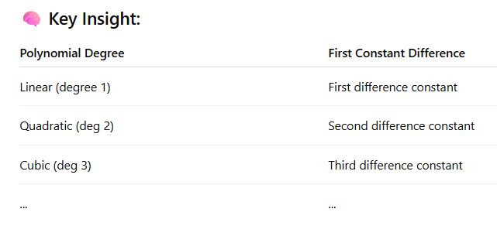

Slide 8
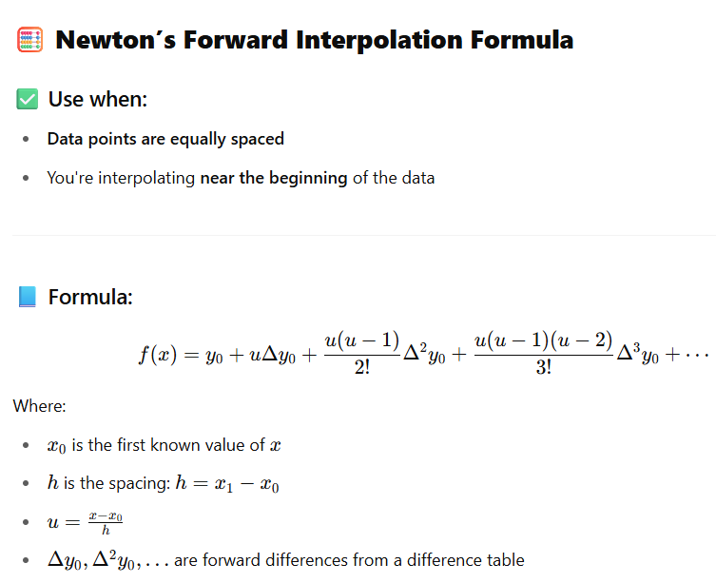

Slide 9
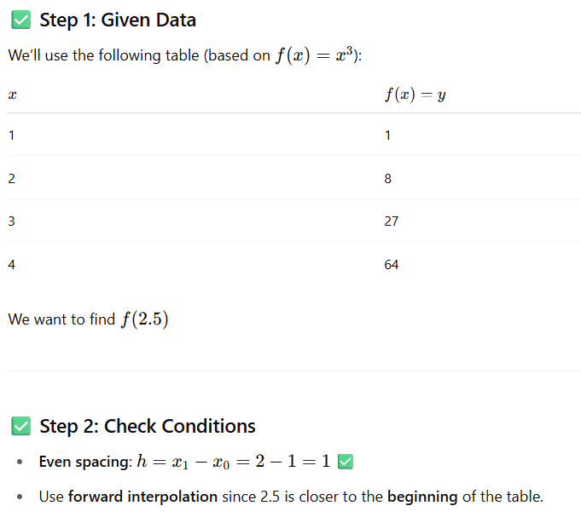
Full step-by-step process of using Newton's Forward Interpolation to find f(2.5).

Slide 10
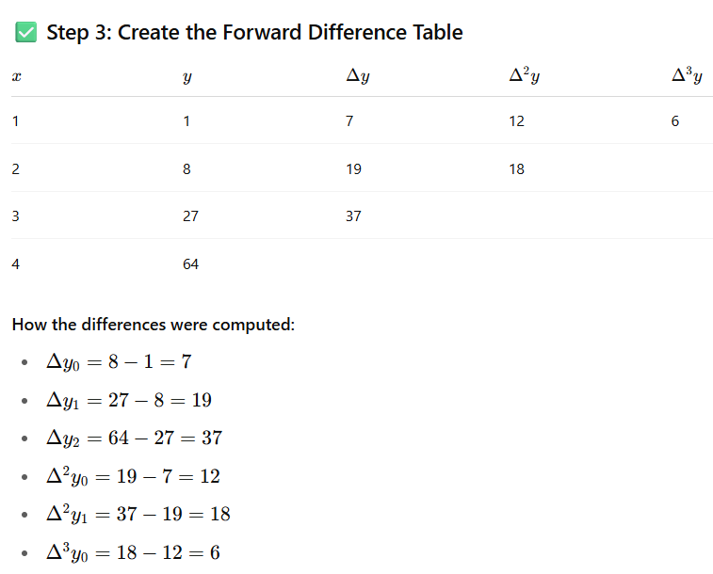
Full step-by-step process of using Newton's Forward Interpolation to find f(2.5).

Slide 11
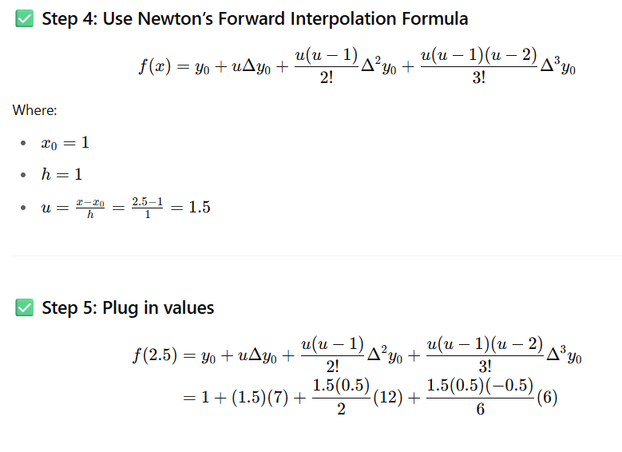
Full step-by-step process of using Newton's Forward Interpolation to find f(2.5).

Slide 12
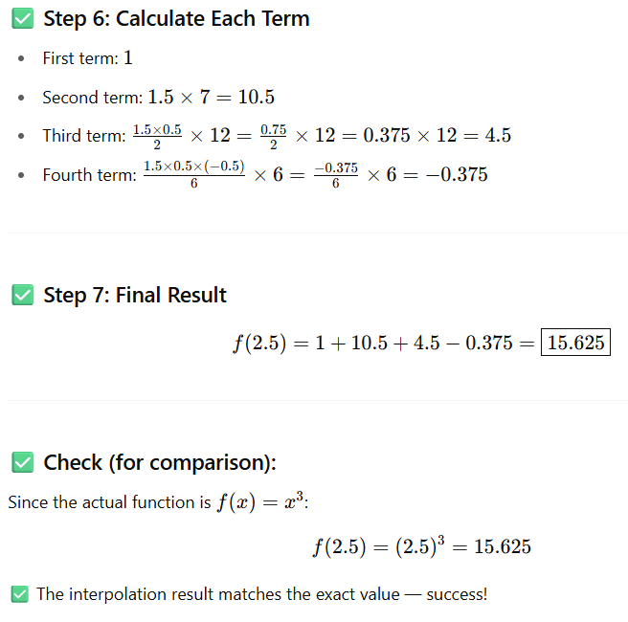
Full step-by-step process of using Newton's Forward Interpolation to find f(2.5).

Slide 13
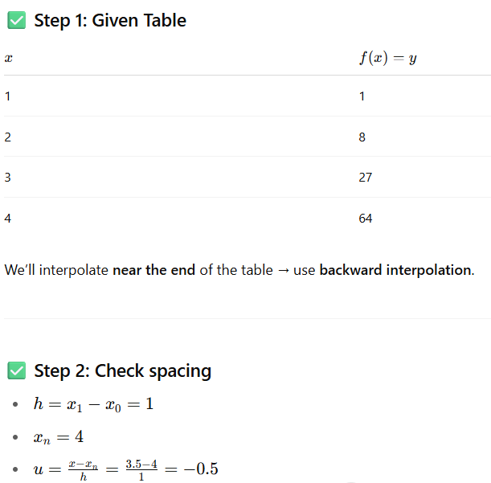
Newton’s Backward Interpolation Formula to compute: f(3.5) Using the same data table:

Slide 14
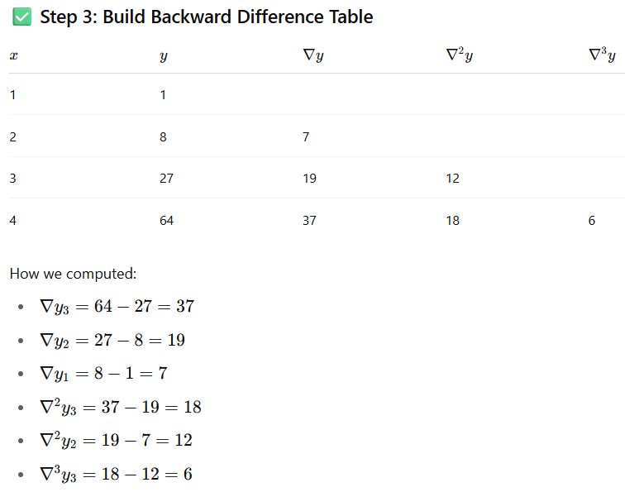
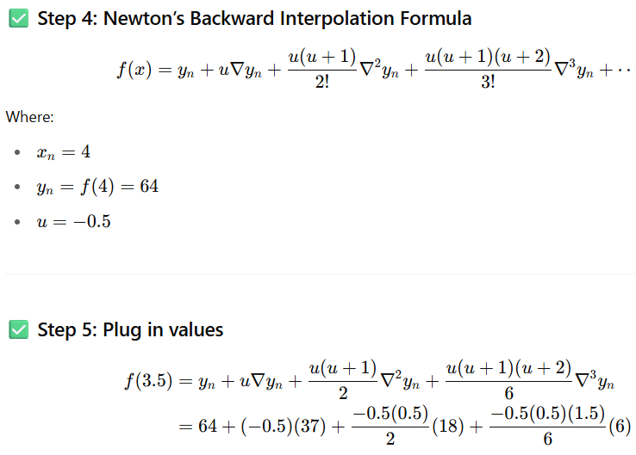
Newton’s Backward Interpolation Formula to compute: f(3.5) Using the same data table:

Slide 15
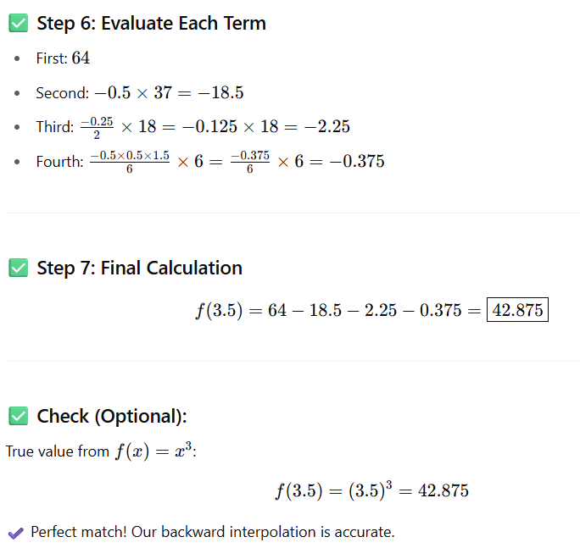
Newton’s Backward Interpolation Formula to compute: f(3.5) Using the same data table:

Slide 16
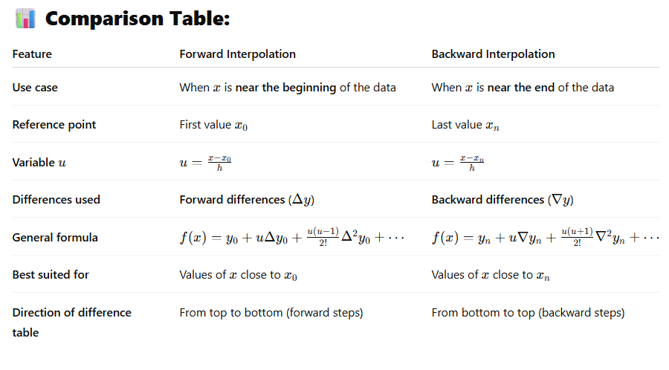
Comparison between Newton’s Forward and Backward Interpolation methods

Slide 17
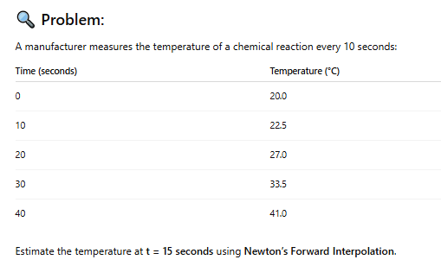

Slide 18
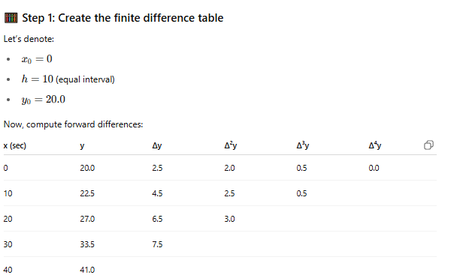

Slide 19
